Slide 1



CEPS Engineering Organization
Integration!
University of New Hampshire
Students for the Exploration and Development of Space

Slide 2
Agenda
Software
Slack
Google Calendar
Trello
OneDrive
Google Drive
Github (Not Today)
Finance
Finance Initiative
Sponsorship Tools
Engineering Placement
Break into Teams
Team-building!
Headshots with Kevin one team at a time
Rocket Building!
University of New Hampshire
Students for the Exploration and Development of Space

Slide 3
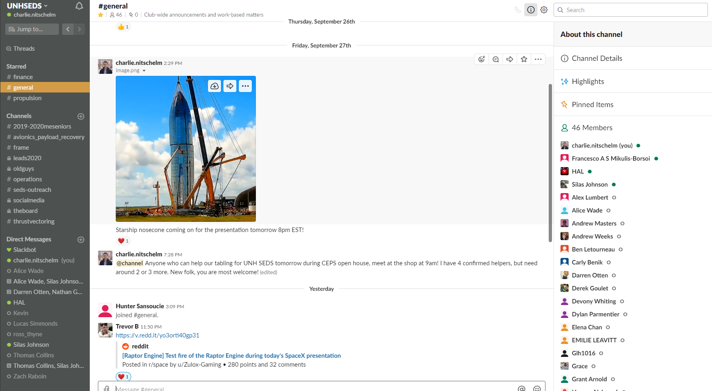
Software - Slack
All Communication
General Announcements
Discussions within Channels
Finance
Engineering teams
Media
Etc.
University of New Hampshire
Students for the Exploration and Development of Space

Slide 4
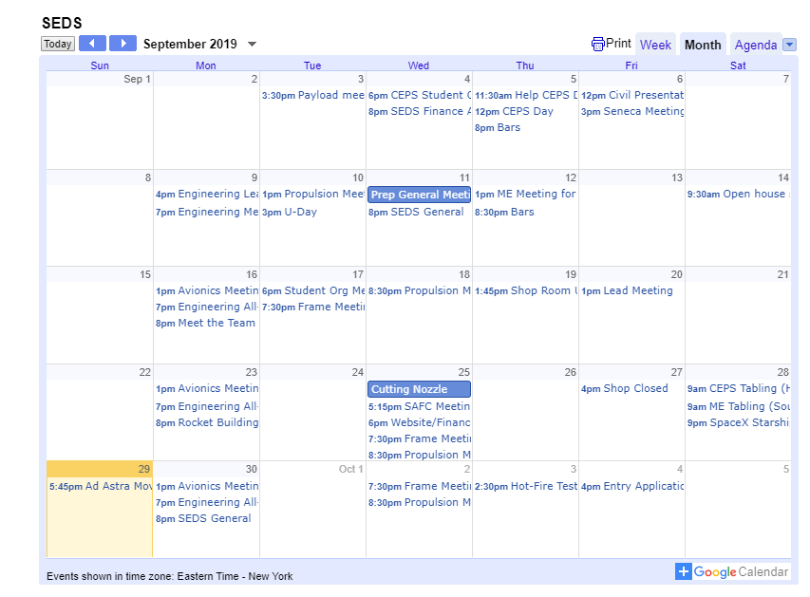
Software – Google Calendar
All Scheduled Events/Meetings
University of New Hampshire
Students for the Exploration and Development of Space

Slide 5
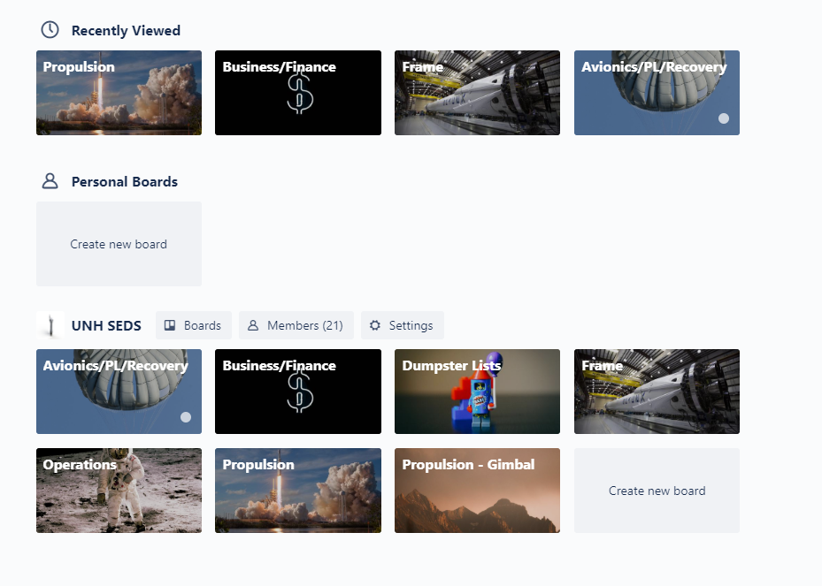
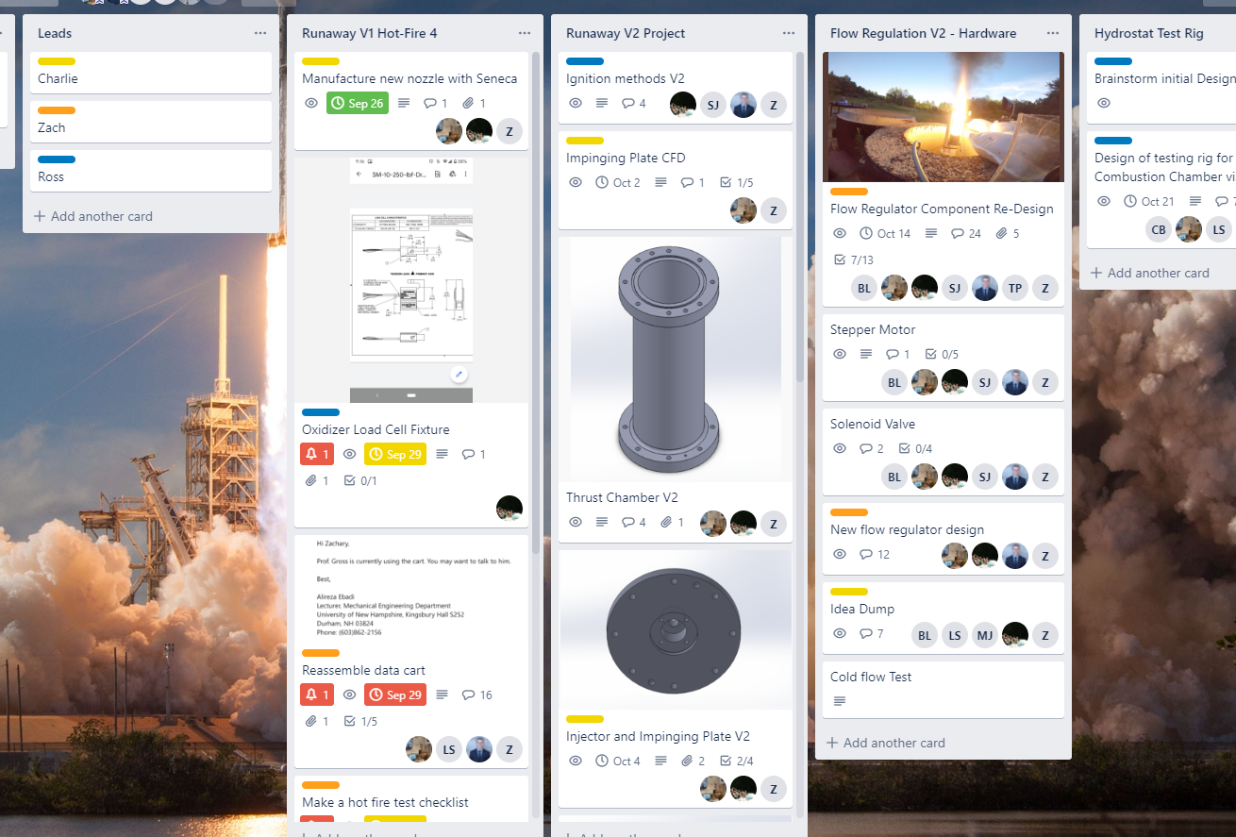
Software – Trello
Organization Tasks
Engineering Teams
Finance
Random
University of New Hampshire
Students for the Exploration and Development of Space

Slide 6
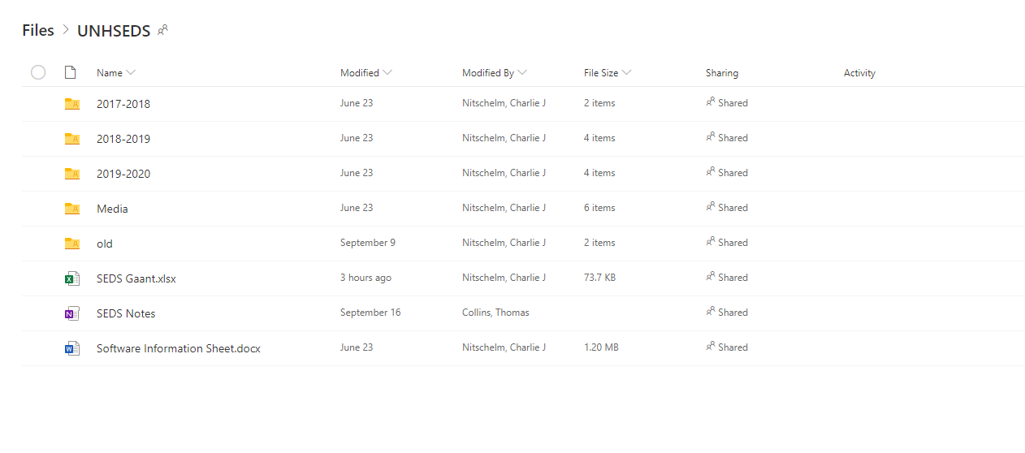
Software – OneDrive
File Storage
Organized files (usually for Microsoft products)
SEDS Gaant
SEDS Notes
Connected to school email
University of New Hampshire
Students for the Exploration and Development of Space

Slide 7
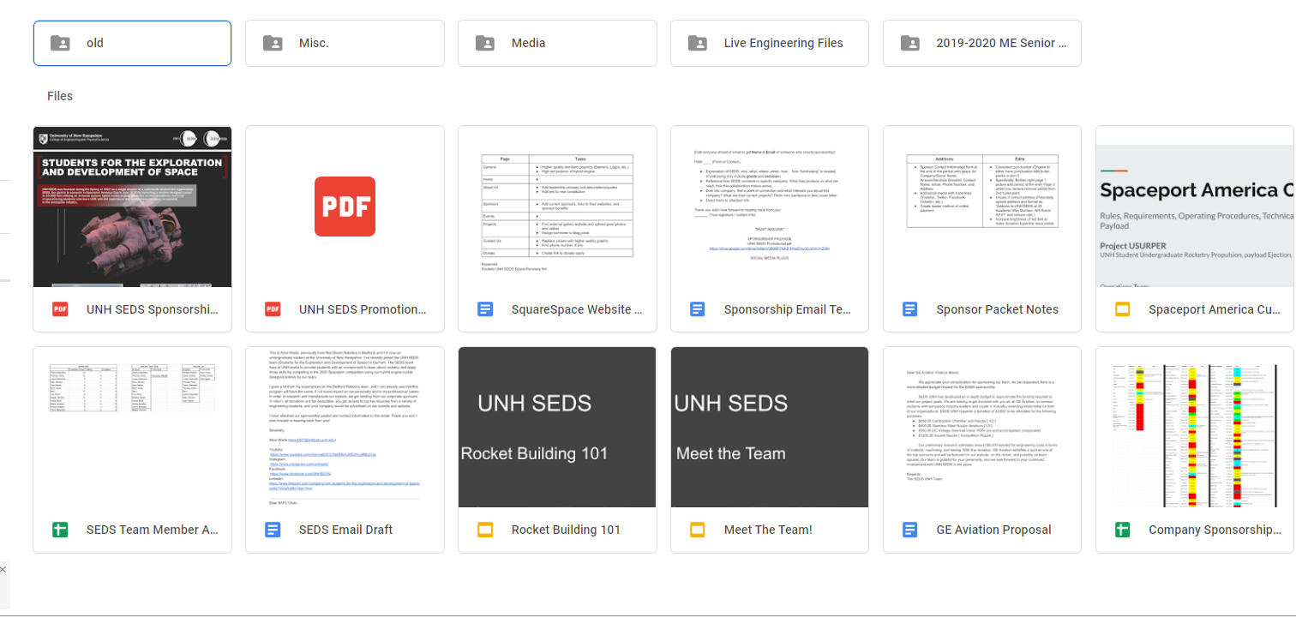
Software – Google Drive
File Storage
Most-used business and media storage
Finance files
Live tracking tools
University of New Hampshire
Students for the Exploration and Development of Space

Slide 8
Software – Github
Later
You can make a github account and download our files @UNH SEDS
University of New Hampshire
Students for the Exploration and Development of Space

Slide 9
Finance Incentive Program
University of New Hampshire
Students for the Exploration and Development of Space

Slide 10
Rules
The levels MUST be met
Non-monetary donations will be estimated for their worth/expected worth in the future to the team.
This is mostly a team-based competition (explained later).
Contest will end November 1st.
University of New Hampshire
Students for the Exploration and Development of Space

Slide 11
Level 1 - $5,000 Total
Charlie Pain Level: 0 out of 5
SEDS BBQ outside the shop for lunch
University of New Hampshire
Students for the Exploration and Development of Space

Slide 12
Level 2 - $8,000 Total
Charlie Pain Level: 2 out of 5
Wear a full-body Chicken Suit the day before we leave to SpaceVision and during all travel (car, TSA, and airplane)
University of New Hampshire
Students for the Exploration and Development of Space

Slide 13
Level 3 - $15,000 Total
Charlie Pain Level: 3 out of 5
Dye my hair any color
Rules:
Can not be dyed during SpaceVision or IAC.
Can get it removed after 2 weeks time
University of New Hampshire
Students for the Exploration and Development of Space

Slide 14
Level 4 - $25,000 Total
Charlie Pain Level: 5 out of 5
Get a tattoo chosen by the team in secret (lower back or ankle)
University of New Hampshire
Students for the Exploration and Development of Space

Slide 15
Level 5 - $30,000 Total
Charlie Pain Level: 6 out of 5
I will do everything from above at the same time
University of New Hampshire
Students for the Exploration and Development of Space

Slide 16
The Richest Engineer
Whoever raises the most money receives:
All expenses paid to SpaceVision from UNH SEDS fo sho
If 21 - all expenses paid bar night from Charlie If not - I will buy liquor for you up to 30 bucks
I will remember what you did and will owe you one (1 Nitschelm buck)
University of New Hampshire
Students for the Exploration and Development of Space

Slide 17
Current Status
We are at around $7,000 right now. Better updated tracking chart coming soon
University of New Hampshire
Students for the Exploration and Development of Space

Slide 18
How do I help get Charlie an ass tattoo?
University of New Hampshire
Students for the Exploration and Development of Space

Slide 19
Engineering Placements
University of New Hampshire
Students for the Exploration and Development of Space

Slide 20
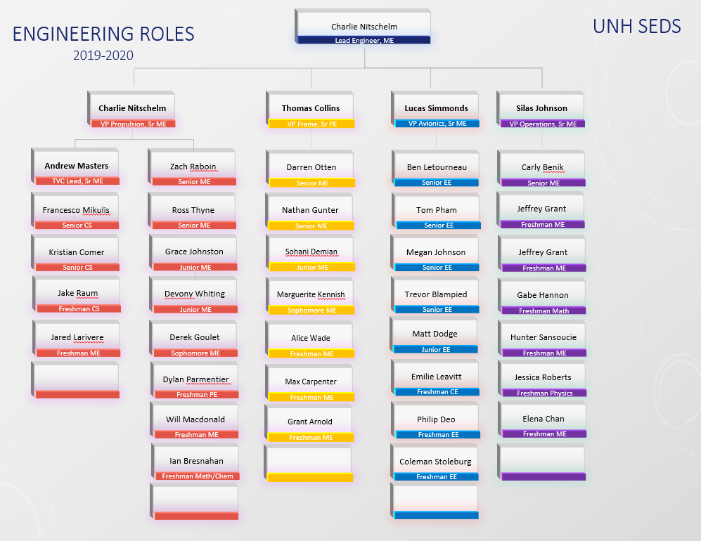
University of New Hampshire
Students for the Exploration and Development of Space

Slide 21
Break into Teams
Team-building!
Headshots with Kevin one team at a time
University of New Hampshire
Students for the Exploration and Development of Space

Slide 22
ROCKET BUILDING!
University of New Hampshire
Students for the Exploration and Development of Space

